Slide 1
Refactoring Continuous Improvement of Your Code Base
@LlewellynFalco

Slide 2
“Our code base is just a big mess, and no one is happy working in it.”
- REDACTED

Slide 3
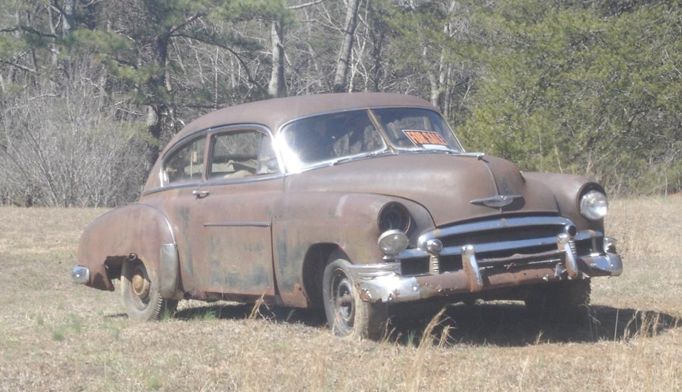

Slide 4
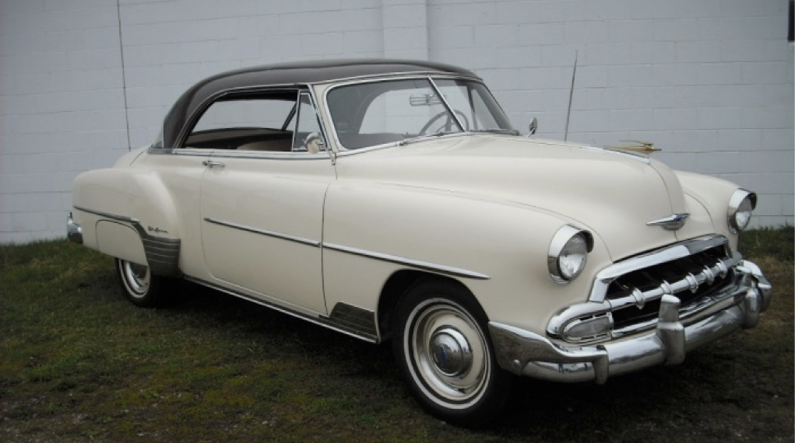

Slide 5
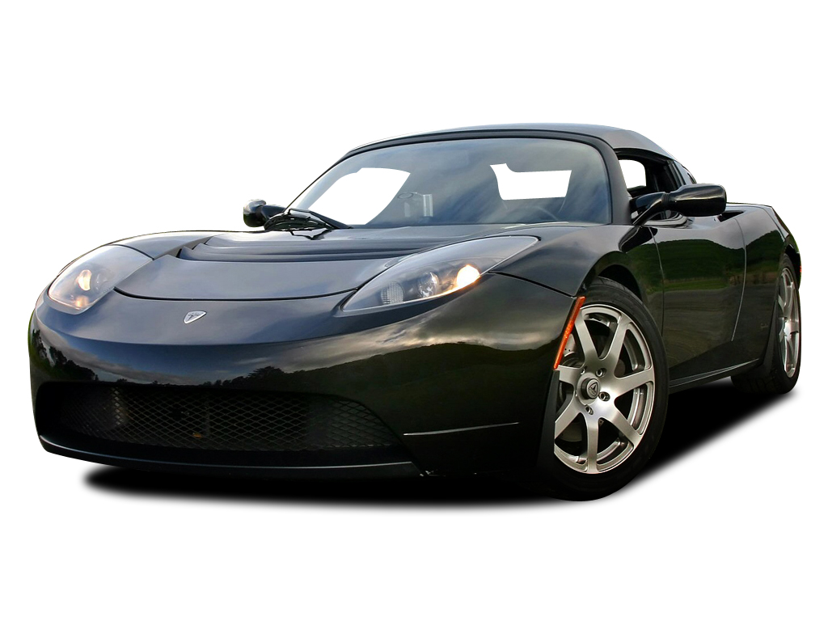

Slide 6
Exercise: The 50 States

Slide 7


Slide 8


Slide 9
Leave things BETTER
than you found them

Slide 10


Slide 12



Slide 13
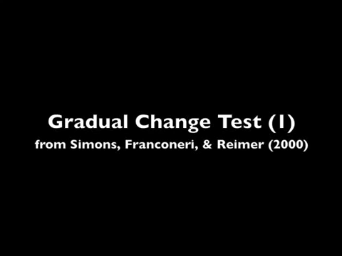

Slide 14
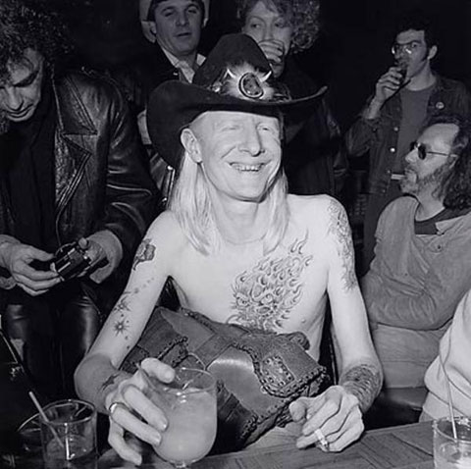
Johnny Winter’s manager had been slowly lowering his methadone dosage for 3 years without Johnny’s knowledge. As a result, Johnny was completely clean of his 40 year heroin addiction for over 8 months before being told he was finally drug free
*http://www.brooklynvegan.com/johnny-winter-r/

Slide 15
Example

Slide 17
Step 1: Remove Clutter

Slide 19
Step 2: Split Long Methods

Slide 20
Step 3: Split Long Methods (again)

Slide 21
Step 4: Extract Classes

Slide 22
Step 5: Create Abstraction

Slide 23
Step 6: Add New Feature

Slide 25
Infinite TASKS

Slide 26
1
2
3
4
5
6

Slide 27
1/2 = .5 1/4 = .25 1/8 = .125 1/16 = .0625 1/32 = 0.03125 … 1/x = 0

Slide 28
SUPER TASKS

Slide 29
1
½
¼
1/8
1/16
1/32

Slide 30
1/1 = 1 [1] 1/2 = .5 [1.5] 1/4 = .25 [1.75] 1/8 = .125 [1.875] 1/16 = .0625 [1.9375] 1/32 = 0.03125 [1.96875] … 1/∞ = 0 [2]

Slide 31
1 (1) * .99 (1 * .99) * .99 = 1 * .99² (1 * .99 * .99) * .99 = 1 * .99³ (1 * .99 * .99 * .99) * .99 = 1 * .99⁴ … 1 * .99^{N}

Slide 32
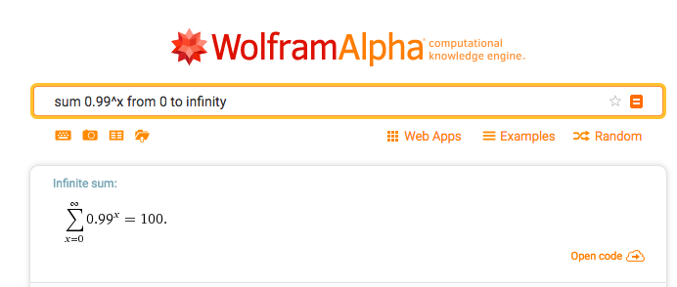

Slide 33
Code Smells

Slide 34
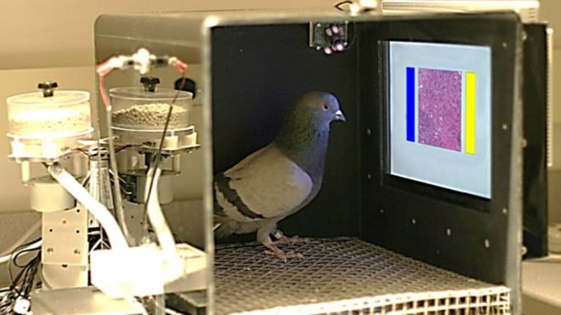
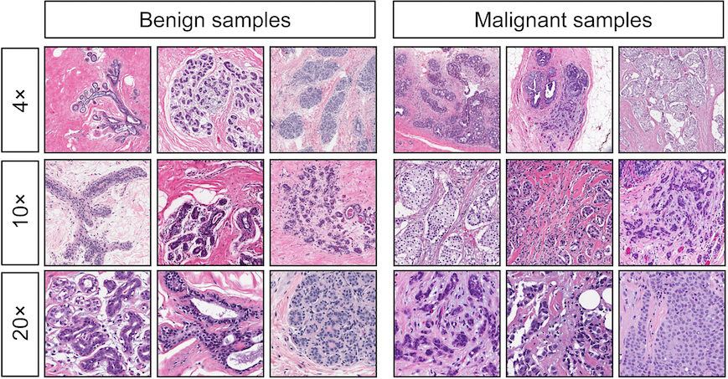
Dr. Pigeon diagnosis cancer
15 days of training
85% successful
University of Iowa
*http://journals.plos.org/plosone/article?id=10.1371/journal.pone.0141357

Slide 35
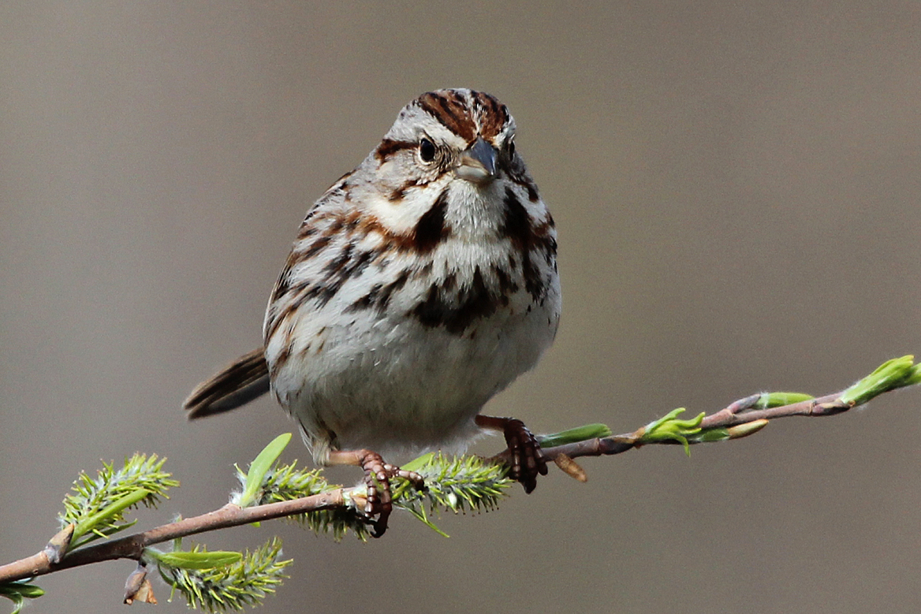
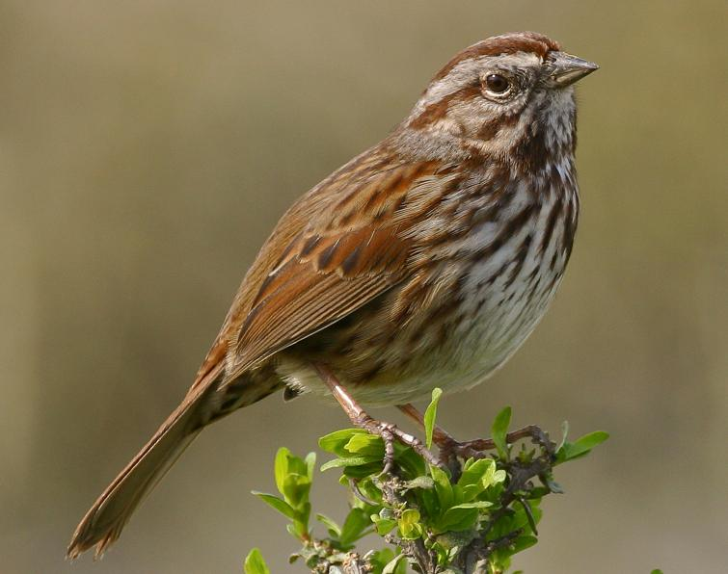
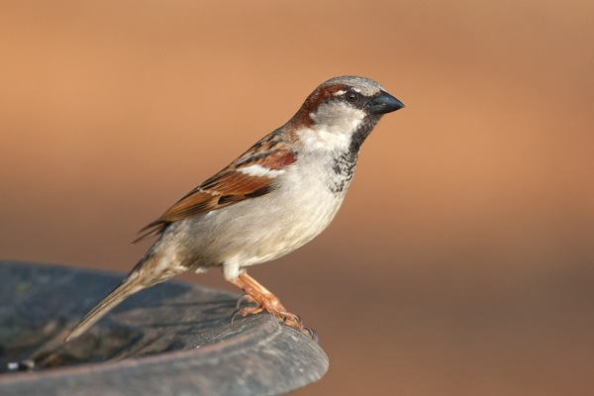
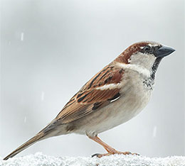
Sparrows Decks
Song
House

Slide 36
Clutter

Slide 37
Time to find things

Slide 38

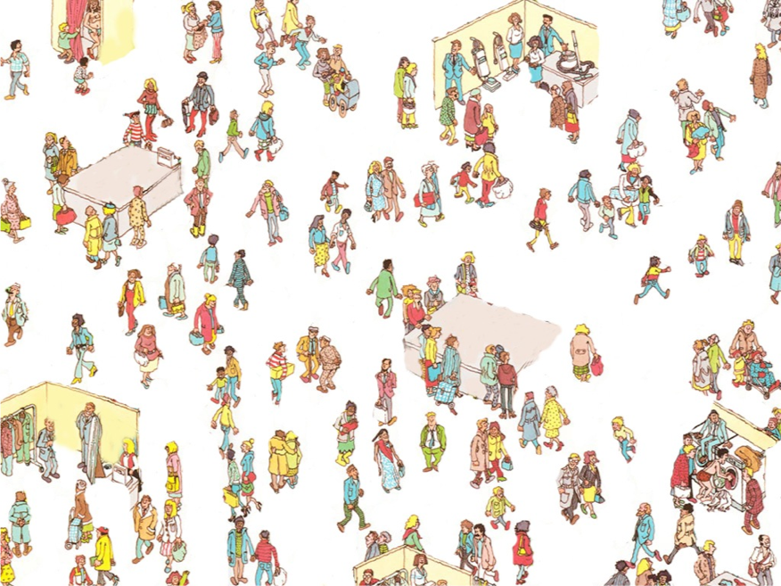
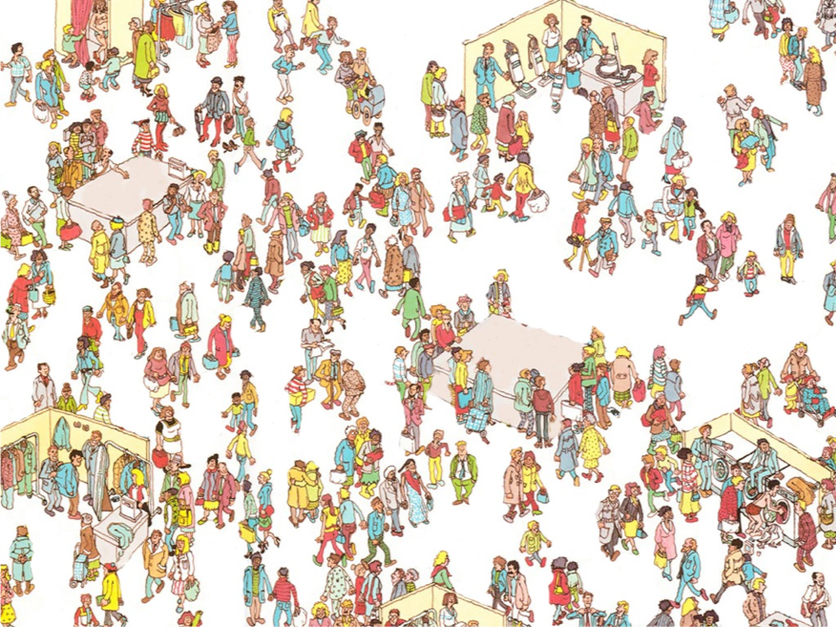
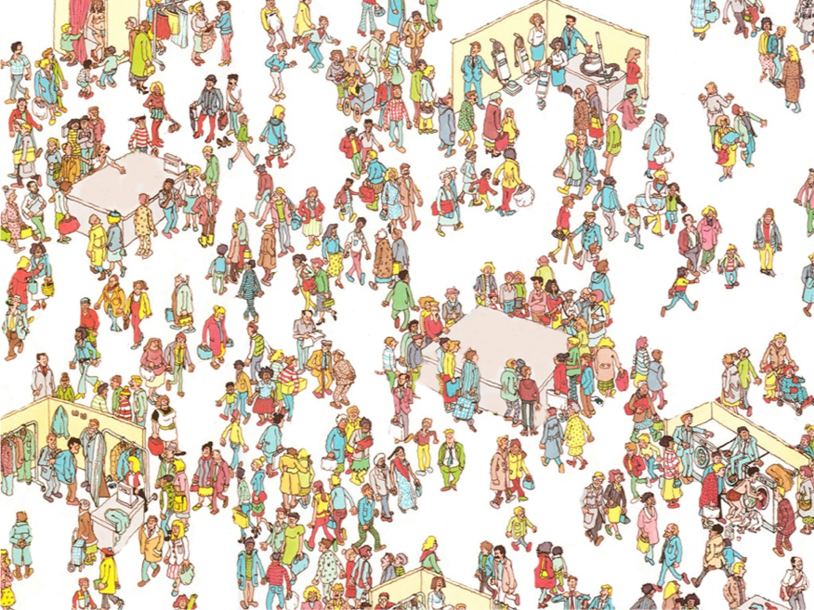
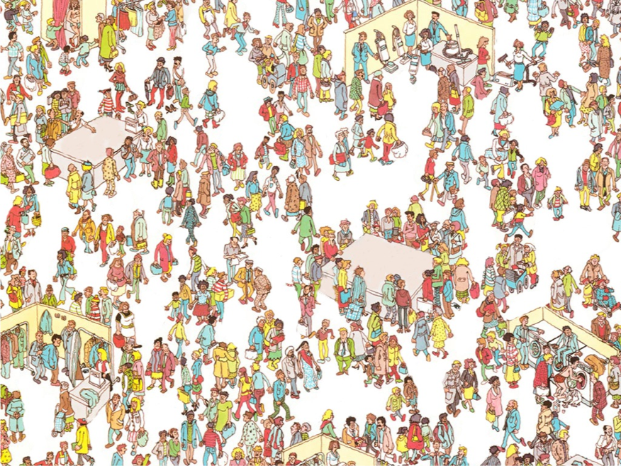

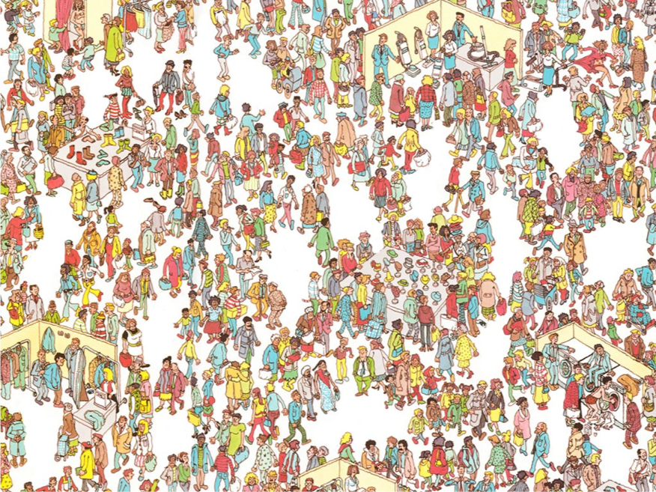
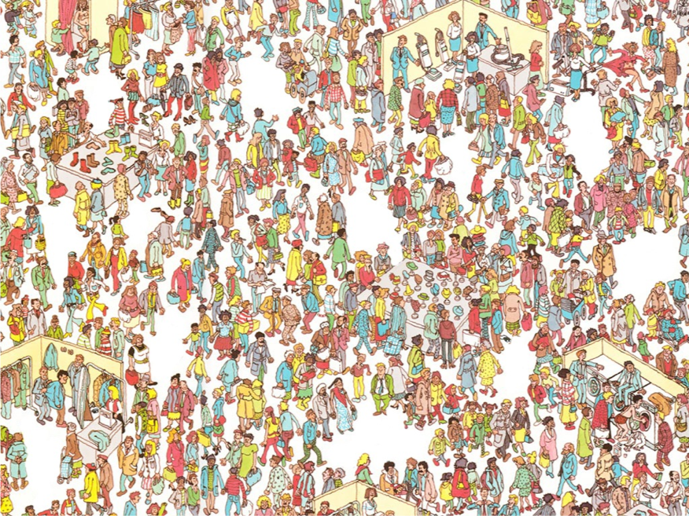
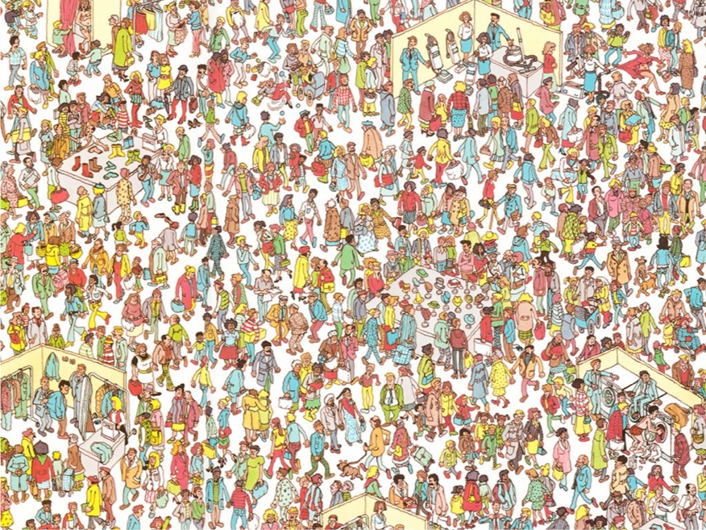

Slide 39
Patterns in the code

Slide 41
Accounts_Receivable Balance_Sheet Cost_of_Goods Expenses Liabilities_2010 Present_Value Profit_And_Loss Outstanding_Invoices
Accounts_Receivable_2010 Balance_Sheet_2010 Cost_of_Goods_2010 Expenses_2010 Liabilities
Present_Value_2010 Profit_And_Loss_2010 Outstanding_Invoices_2010
Accounts_Receivable_2010 Balance_Sheet_2010 Cost_of_Goods_2010 Expenses_2010 Liabilities Present_Value_2010 Profit_And_Loss_2010 Outstanding_Invoices_2010

Slide 42
Long Methods
// If a license key has been located...
if (licenseKey != null) {
// Decrypt
licenseKey = ActiproLicenseProvider.DecryptString(licenseKey, encryptionKey);
// Find the licensee and license key
string[] licenseKeyData = licenseKey.Split(new Char[] { ';' });
if (BrowserInteropHelper.IsBrowserHosted) {
// XBAP licensing uses required assembly / licensee / license key
// Ensure that the specified assembly is in the AppDomain
string requiredAssemblyName = licenseKeyData[0].Trim();
Assembly[] assemblies = AppDomain.CurrentDomain.GetAssemblies();
bool assemblyFound = false;
foreach (Assembly loadedAssembly in assemblies) {
if (loadedAssembly.FullName.StartsWith(requiredAssemblyName + ",", StringCompari
assemblyFound = true;
break;
}
}
if ((assemblyFound) && (plainTextLicensee == licenseKeyData[2]) && (String.Compare
// Assembly was found so use license data
licensee = licenseKeyData[2];
licenseKey = licenseKeyData[1];
sourceLocation = ActiproLicenseSourceLocation.AssemblySavedContext;
}
}
else {
// Regular licensing just uses licensee / license key
licensee = licenseKeyData[1];
licenseKey = licenseKeyData[0];
sourceLocation = ActiproLicenseSourceLocation.AssemblySavedContext;
}

Slide 43
Merge Conflict

Slide 44
Encapsulation & Readability

Slide 45
The 7 stages of naming
By ArloBelshee
Nonsense
Honest
Honest &
Complete
Does the
Right Thing
Intent
Domain
Abstraction
Missing
Start
Structural
Refactoring
ParseXml
AndStoreFlight
ToDatabase
AndLocalCache
AndStart
Processing()
DoSomething
EvilTo
Database()
Begin
Tracking
Flight()
Monitoring
Panel
.Add(flight)
Foo()
StoreFlight
ToDatabase
AndStart
Processing()

Slide 46
The 7 stages of naming
Nonsense
Missing
// If a license key has been located...
if (licenseKey != null) {
// Decrypt
licenseKey = ActiproLicenseProvider.DecryptString(licenseKey, encryptionKey);
// Find the licensee and license key
string[] licenseKeyData = licenseKey.Split(new Char[] { ';' });
if (BrowserInteropHelper.IsBrowserHosted) {
// XBAP licensing uses required assembly / licensee / license key
// Ensure that the specified assembly is in the AppDomain
string requiredAssemblyName = licenseKeyData[0].Trim();
Assembly[] assemblies = AppDomain.CurrentDomain.GetAssemblies();
bool assemblyFound = false;
foreach (Assembly loadedAssembly in assemblies) {
if (loadedAssembly.FullName.StartsWith(requiredAssemblyName + ",", StringCompari
assemblyFound = true;
break;
}
}
if ((assemblyFound) && (plainTextLicensee == licenseKeyData[2]) && (String.Compare
// Assembly was found so use license data
licensee = licenseKeyData[2];
licenseKey = licenseKeyData[1];
sourceLocation = ActiproLicenseSourceLocation.AssemblySavedContext;
}
}
else {
// Regular licensing just uses licensee / license key
licensee = licenseKeyData[1];
licenseKey = licenseKeyData[0];
sourceLocation = ActiproLicenseSourceLocation.AssemblySavedContext;
}
Foo()

Slide 47
The 7 stages of naming
Nonsense
Honest
DoSomething
EvilTo
Database()
Foo()

Slide 48
The 7 stages of naming
ParseXml
AndStoreFlight
ToDatabase
AndLocalCache
AndStart
Processing()
Honest
Honest &
Complete
DoSomething
EvilTo
Database()

Slide 49
The 7 stages of naming
Honest &
Complete
Does the
Right Thing
ParseXml
AndStoreFlight
ToDatabase
AndLocalCache
AndStart
Processing()
StoreFlight
ToDatabase
AndStart
Processing()
Start
Structural
Refactoring

Slide 50
The 7 stages of naming
Does the
Right Thing
Intent
StoreFlight
ToDatabase
AndStart
Processing()
Begin
Tracking
Flight()

Slide 51
The 7 stages of naming
Intent
Domain
Abstraction
Begin
Tracking
Flight()
Monitoring
Panel
.Add(flight)

Slide 52
The 7 stages of naming
By ArloBelshee
Nonsense
Honest
Honest &
Complete
Does the
Right Thing
Intent
Domain
Abstraction
Missing
Start
Structural
Refactoring
ParseXml
AndStoreFlight
ToDatabase
AndLocalCache
AndStart
Processing()
DoSomething
EvilTo
Database()
Begin
Tracking
Flight()
Monitoring
Panel
.Add(flight)
Foo()
StoreFlight
ToDatabase
AndStart
Processing()

Slide 53
Arlo Git Notation github.com/RefactoringCombos/ArlosCommitNotation

Slide 54
prefix | Risk | meaning
F | High | Feature
B | High | Bug
t | low | Test only
r | low | Provable Refactor
a | low | Automated
!!! | High | non-provable refactoring

Slide 55
* 7eb8bac - F Conjured items (20 hours ago) <Llewellyn Falco>
* 102edc6 - r public static (20 hours ago) <Llewellyn Falco>
* b70fffc - r Inline (20 hours ago) <Llewellyn Falco>
* 7a4d940 - r Extract Method (20 hours ago) <Llewellyn Falco>
* 8b70b9c - r Extract Variable (20 hours ago) <Llewellyn Falco>
* 70a73ac - r looped (20 hours ago) <Llewellyn Falco>
* 64e736c - r looping (20 hours ago) <Llewellyn Falco>
* 7659cc8 - r to many of 1 (20 hours ago) <Llewellyn Falco>
* e68d810 - r implementing item updater (20 hours ago) <Llewellyn Falco>
* 2f43d6c - r implementing item updater (20 hours ago) <Llewellyn Falco>
* b42cbcf - r added item (20 hours ago) <Llewellyn Falco>
* f9a9ffa - r interface (20 hours ago) <Llewellyn Falco>
* 89a406a - r public (20 hours ago) <Llewellyn Falco>
* 342e2c1 - r Rename (20 hours ago) <Llewellyn Falco>
* c271979 - r Rename (20 hours ago) <Llewellyn Falco>
* 58ef751 - r Rename (20 hours ago) <Llewellyn Falco>
* 09a5ce0 - r Rename (20 hours ago) <Llewellyn Falco>
* 721a412 - r seperate (20 hours ago) <Llewellyn Falco>
* 60418e8 - r seperate (20 hours ago) <Llewellyn Falco>
* 08917e4 - r dead code (20 hours ago) <Llewellyn Falco>
* 7eb3018 - r seperate (20 hours ago) <Llewellyn Falco>
* a1c5b36 - r seperate (20 hours ago) <Llewellyn Falco>
* 96ad3f1 - r Rename (20 hours ago) <Llewellyn Falco>
* 30244ee - r dead code (20 hours ago) <Llewellyn Falco>
* 5335fa6 - r seperate (20 hours ago) <Llewellyn Falco>
* 9f4ad5c - r seperate (20 hours ago) <Llewellyn Falco>
* 37c416c - r added dead code (20 hours ago) <Llewellyn Falco>
* 58f7f97 - r seperated class (20 hours ago) <Llewellyn Falco>
* 6d8f385 - r aged brie (21 hours ago) <Llewellyn Falco>
* ca0c832 - r Extract Variable (21 hours ago) <Llewellyn Falco>
* f466a84 - r extract superclass (21 hours ago) <Llewellyn Falco>
* 64c2738 - r extract superclass (21 hours ago) <Llewellyn Falco>
* 2501cd3 - r extract superclass (21 hours ago) <Llewellyn Falco>
* c76b23f - r extracted Brie (21 hours ago) <Llewellyn Falco>
* 7165da3 - r Delete Clutter (21 hours ago) <Llewellyn Falco>
* 09b4675 - r Extract Method (21 hours ago) <Llewellyn Falco>
* 11fcb91 - r Extract Method (21 hours ago) <Llewellyn Falco>
* c1def3d - r Extract Method (21 hours ago) <Llewellyn Falco>

Slide 56
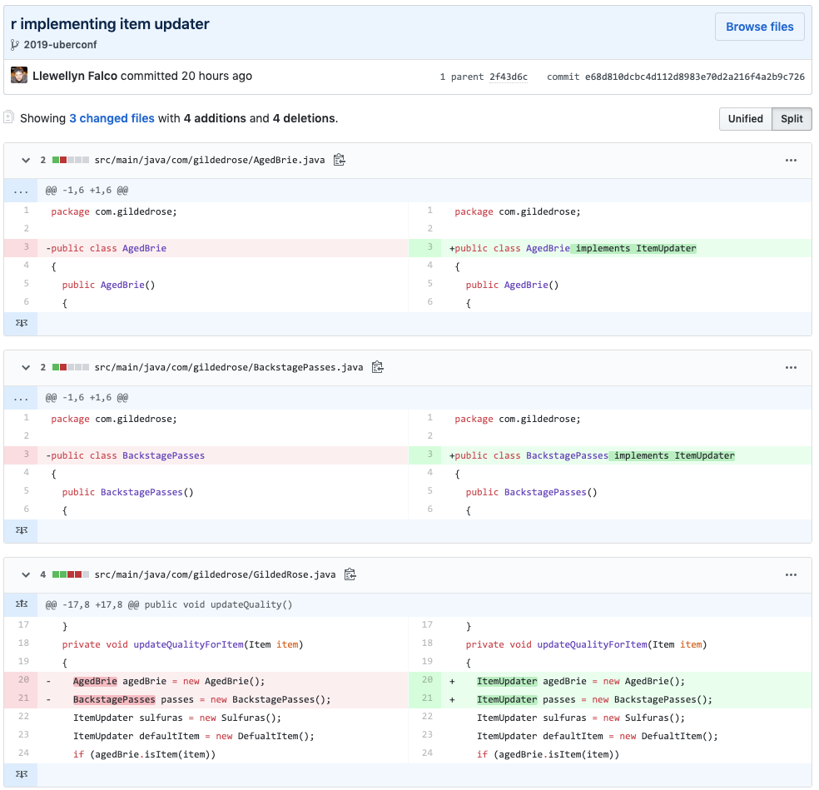

Slide 57
* b70fffc - r Inline
* 7a4d940 - r Extract Method
* 8b70b9c - r Extract Variable
* 70a73ac - r Deleted dead code
* 2f43d6c - !!! Simpler formula
* 89a406a - r Rename
* c271979 - r Rename
* 58ef751 - r Rename
* 09a5ce0 - r Rename
* 721a412 - !!! Extract Method
* 60418e8 - r Inline
* 08917e4 - r Joined Initiations
* 9f4ad5c - r Extract

Slide 58
voltage = (incoming * normalizer) / normalizer;
voltage = incoming;

Slide 59
10 X

Slide 60
What does 10X look like?

Slide 61
$1 @ 10% interest For 1 Year
Total: $1.10
$1 @ 100% interest For 1 Year
Total: $2.00

Slide 62
$1 @ 10% interest For 20 Years
Total: $6.73
$1 @ 100% interest For 20 Years
Total: $1,048,576.00

Slide 63
Gross: $100,000 Gross: $145,000
Overhead: $95,000
($5K Profit)
($50K Profit)

Slide 64
Loan: $100,000 @ 10% interest $839 $2124
(50 years)
(5 years)

Slide 65
Interest: $100,000 @ 100% interest $8,333
(50 years)
$8,402
(5 years)

Slide 66
Person 1: $100 a Month for 17 Years
Person 2: $100 a Month for 17 Years

Slide 67
Person 1: $100 a Month for 17 Years
Person 2: $100 a Month for 17 Years

Slide 68
Person 1: $100 a Month for 17 Years
$530k
$53k
Person 2: $100 a Month for 17 Years

Slide 69
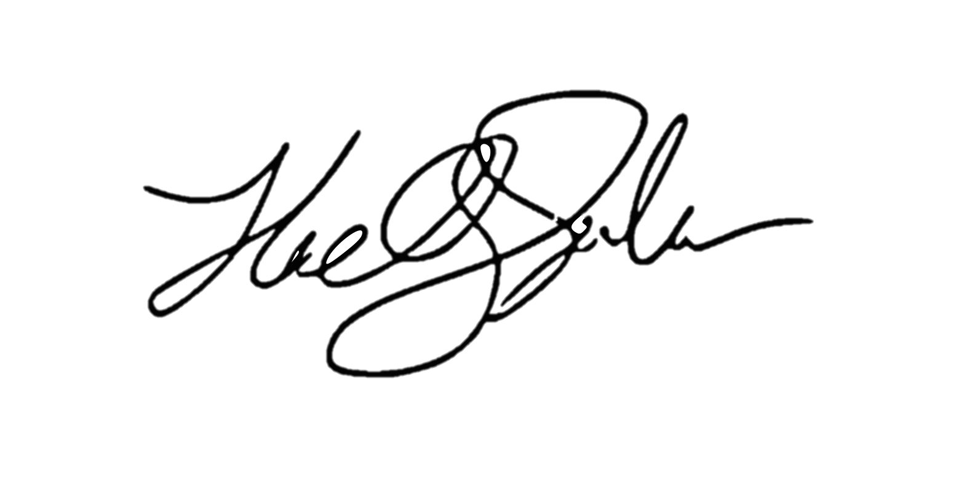
ROI of investing1 hour a day
for a 1% increase ( 5 minutes )
5x (1 year)
4x (10 months)
Output
2x (6 months)
3x (8.5 months)
28 days
Llewellyn Falco

Slide 70
Resources

Slide 71
Breakout Session
Code Refactoring – A Workshop
com.services.business.
appraisalassignment.web.ui.
AssignmentSupplement.
ChangeAssignmentDetailsAsPerMOI()
[745 lines]
Laptop
White Board

Slide 72
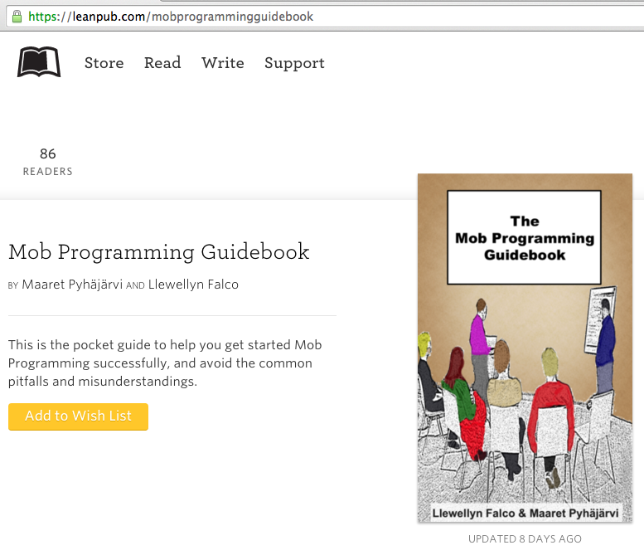
#MobProgrammingGuidebook

Slide 73
LlewellynFalco.blogspot.com/SparrowDecks  clutter  long lines  long methods   bad names  duplication  inconsistency 

Slide 74
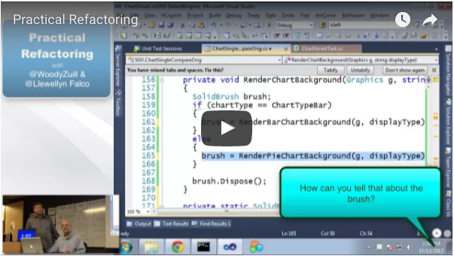
bit.ly/PracticalRefactoring

Slide 75
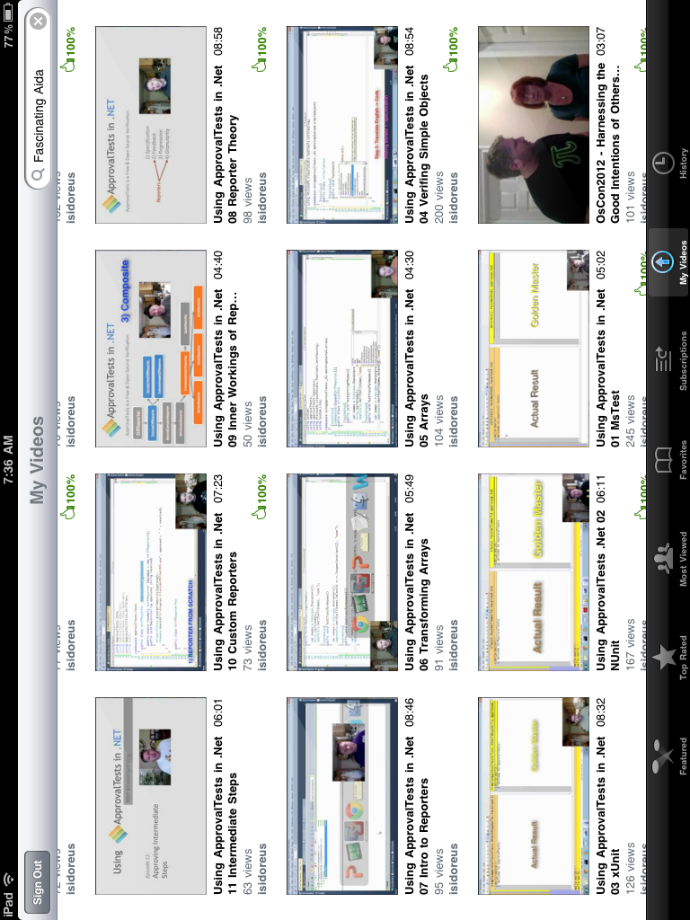
www.ApprovalTests.com
21 episode YouTube series
Notes:
Both

Slide 76
“The best time to plant a tree is 20 years ago.
The second best time is now.”

Slide 77

Thank YOU (please connect via LinkedIn and Twitter)
@LlewellynFalco
youtube.com/isidoreus
LlewellynFalco.Blogspot.com approvaltests.com

